Slide 1
Reference text 1
Title: Introduction to Natural Language Processing
Author: Jacob Eisenstein
Year: 2019
Draft PDF available at https://bit.ly/2U6HZ5f

Slide 2
Reference textbook 2
Title: Natural Language Processing with PyTorch: Build Intelligent Language Applications Using Deep Learning
Author: Delip Rao
Year: 2019

Slide 3
Reference textbook 3
Title: Neural Network Methods for Natural Language Processing
Author: Yoav Goldberg
Year: 2017
311 Pages
Alternatively,
A Primer on Neural Network Models for Natural Language Processing
Journal of Artificial Intelligence Research
Freely available online

Slide 4
Machine Translation
Instructor: Kyunghyun Cho (NYU, Facebook)

Slide 5
Recurrent Language Modeling
Let’s delve a bit deeper into a recurrent network and language modeling with it.

Slide 6
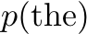
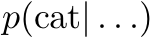
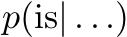
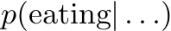
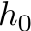
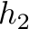
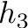
Recurrent Language Model
Example)
Read, Update and Predict

Slide 7
Building a Recurrent Language Model
Transition Function
Inputs
Previous word
Previous state
Parameters
Input weight matrix
Transition weight matrix
Bias vector
Naïve Transition Function

Slide 8
Building a Recurrent Language Model
Transition Function
Naïve Transition Function
Element-wise nonlinear
transformation
Linear transformation of
previous state
Trainable word vector

Slide 9
Building a Recurrent Language Model
Readout Function
Inputs
Current state
Parameters
Readout weight matrix
Bias vector
Softmax Readout

Slide 10
Building a Recurrent Language Model
Readout Function
Exponentiation
Normalization
Compatibility between a trainable word vector and
the hidden state

Slide 11
Training a Recurrent Language Model
Log-probability of one training sentence
Training set
Log-likelihood Functional
Minimize !!

Slide 12
Minibatch Stochastic Gradient Descent
Building a minibatch is not trivial due to length differences.
Sentence 1
Sentence 2
Sentence 3
Sentence 4
Padding and Masking: suitable for GPU’s, but wasteful
Wasted computation:
Sentence 1
0’s
Sentence 2
0’s
Sentence 3
Sentence 4
0’s

Slide 13
Minibatch Stochastic Gradient Descent
Padding and Masking: suitable for GPU’s, but wasteful
Wasted computation:
Sentence 1
0’s
Sentence 2
0’s
Sentence 3
Sentence 4
0’s
Smarter Padding and Masking: minimize the waste
Ensure that the length differences are minimal.
Sort the sentences and sequentially build a minibatch
Sentence 1
0’s
Sentence 2
0’s
Sentence 3
0’s
Sentence 4

Slide 14
Minibatch Stochastic Gradient Descent
Smarter Padding and Masking: minimize the waste
Sentence 1
0’s
Sentence 2
0’s
Sentence 3
0’s
Sentence 4
Smarter Padding and Smarter Stopping: toward zero waste
Drop a finished sentence from a minibatch
Not as flexible…
Sentence 1
0’s
Sentence 2
0’s
Sentence 3
0’s
Sentence 4

Slide 15
Backpropagation through Time
How do we compute ?
Decompose the per-sample cost into per-step cost functions
Compute per-step cost function from time
Cost derivative
Gradient w.r.t. :
Gradient w.r.t. :
Gradient w.r.t. :
Gradient w.r.t. and : and
Accumulate the gradient and
Note: I’m abusing math a lot here!!

Slide 16
Backpropagation through Time
Intuitively, what’s happening here?
Measure the influence of the past on the future
If I perturb the input at , how does it affect ?

Slide 17
Backpropagation through Time
Intuitively, what’s happening here?
Measure the influence of the past on the future
If I perturb the input at , how does it affect ?
Change the parameters so as to maximize

Slide 18
Backpropagation through Time
Intuitively, what’s happening here?
Measure the influence of the past on the future
With a naïve transition function We get
Problematic!
– Bengio et al. (1994)

Slide 19
Backpropagation through Time
Gradient either vanishes or explodes
Pascanu et al. (2013)
What happens?
The gradient likely explodes if
The gradient likely vanishes if
: largest eigenvalue of

Slide 20
Backpropagation through Time
Let the (norm of the) gradient explode!
“when gradients explode so does the curvature along v, leading to a wall in the error surface”
Simple solution: Gradient Clipping
Norm clipping
Element-wise clipping
Pascanu et al. (2013)

Slide 21
Backpropagation through Time
Vanishing gradient is super-problematic
We cannot tell whether
no long-term dependency between t and t+n in data, or
wrong configuration of parameters:
We only observe

Slide 22
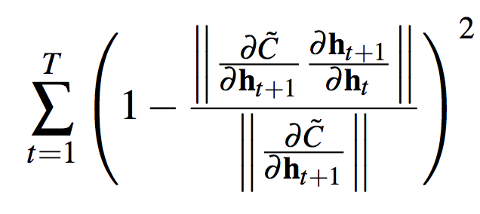
Backpropagation through Time
Vanishing gradient is super-problematic
Let’s just say there is such a long-term dependency. Then,
“we … force the network to increase the norm of at the expense of larger errors”
This can be done by regularizing
This doesn’t seem like a great nor easy way to deal with the vanishing gradient.
Pascanu et al. (2013)

Slide 23
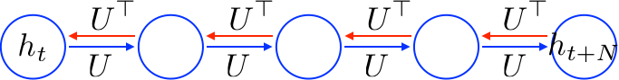
Gated Recurrent Unit
Perhaps, the problem is with the naïve transition function
With it, the temporal derivative is
It implies that the error must backpropagate through all the intermediate nodes:

Slide 24
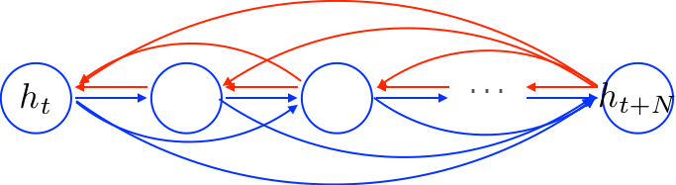
Gated Recurrent Unit
It implies that the error must backpropagate through all the intermediate nodes:
Perhaps we can create shortcut connections.

Slide 25
Gated Recurrent Unit
Perhaps we can create adaptive shortcut connections.
Candidate Update
Update gate

Slide 26
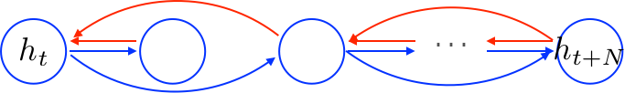
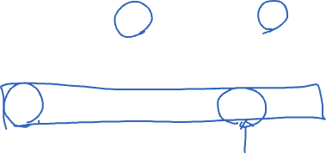
Gated Recurrent Unit
We also let the network prune unnecessary shortcuts adaptively.
Candidate Update
Reset gate
Update gate

Slide 27
Gated Recurrent Unit
tanh-RNN vs CPU
Registers
Execution
Read the whole register
Update the whole register

Slide 28
Gated Recurrent Unit
GRU vs CPU
Registers
Execution
Select a readable subset
Read the subset
Select a writable subset
Update the subset
Clearly gated recurrent units* are much more realistic.
* By gated recurrent units, I refer to both LSTM and GRU.

Slide 29
Machine Translation: a Natural Extension of Neural Language Modeling
You have already learned how to build it.

Slide 30
Machine Translation
Input: a sentence written in a source language
Output: a corresponding sentence in a target language
Problem statement:
Supervised learning: given the input sentence, output its translation
Compute the conditional distribution over all possible translation given the input
We have already learned every necessary ingredient for building a full neural machine translation system.

Slide 31
Token Representation – One-hot Vectors
Build source and target vocabularies of unique tokens
For each of source and target languages,
Tokenize: separate punctuations, normalize punctuations, … e.g., “I’m going” => (“I”, “’m”, “going”), replace ‘, ’, `, into “`”, … use Spacy.io, NLTK or Moses’ tokenizer.
Subword segmentation: segment each token into a sequence of subwords e.g., “going” => (“go”, “ing”), use BPE [Sennrich et al., 2015]
Collect all unique subwords, sort them by their frequencies (descending) and assign indices.
Transform each subword token into a corresponding one-hot vector.*
* Of course, don’t do it offline. Transform them online.

Slide 32
Encoder – Source Sentence Representation
Encode the source sentence into a set of sentence representation vectors
# of encoded vectors is proportional to the source sentence length: often same.
Recurrent networks have been widely used [Cho et al., 2014; Sutskever et al., 2014], but CNN [Gehring et al., 2017; Kalchbrenner&Blunsom, 2013] and self-attention [Vaswani et al., 2017] are used increasingly more often. See Lecture 2 for details.
We do not want to collapse them into a single vector.
Collapsing often corresponds to information loss.
Increasingly more difficult to encode the entire source sentence into a single vector, as the sentence length increases [Cho et al., 2014b].
We didn’t know initially until [Bahdanau et al., 2015].

Slide 33
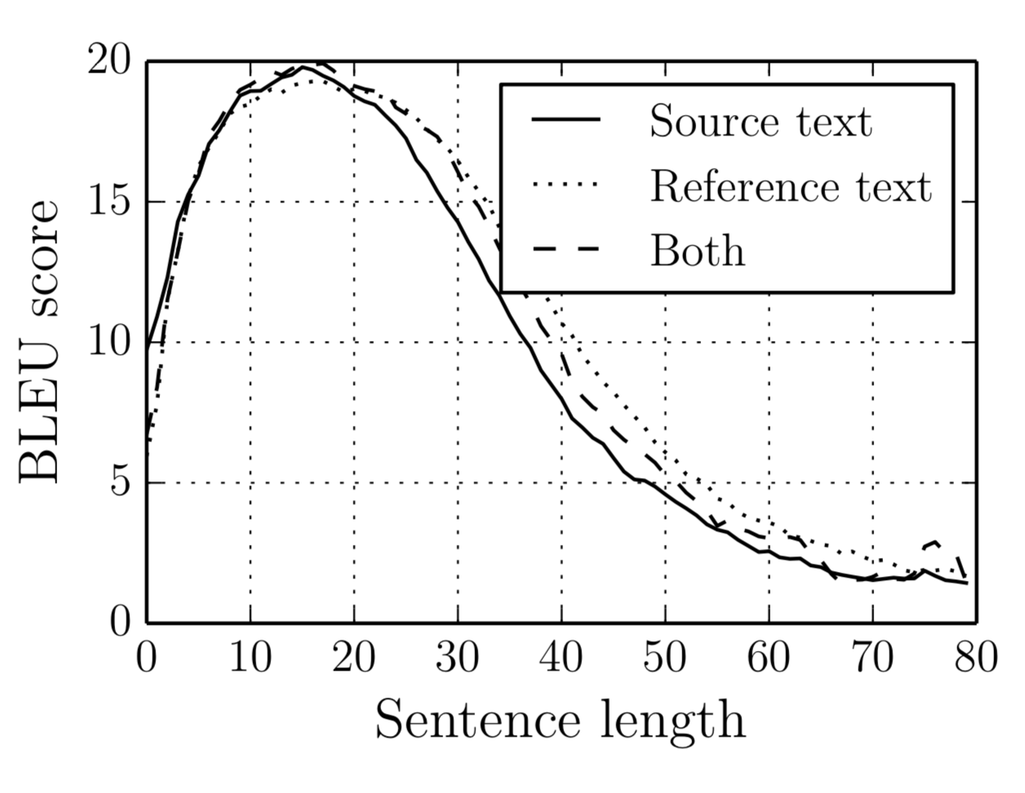
Encoder – Source Sentence Representation
Encode the source sentence into a set of sentence representation vectors
We do not want to collapse them into a single vector.
Increasingly more difficult to encode the entire source sentence into a single vector, as the sentence length increases [Cho et al., 2014b].

Slide 34
Encoder – Source Sentence Representation
Encode the source sentence into a set of sentence representation vectors
We do not want to collapse them into a single vector.
Increasingly more difficult to encode the entire source sentence into a single vector, as the sentence length increases [Cho et al., 2014b].
When collapsed, the system fails to translate a long sentence correctly.
Source: An admitting privilege is the right of a doctor to admit a patient to a hospital or a medical centre to carry out a diagnosis or a procedure, based on his status as a health care worker at a hospital.
When collapsed: Un privilège d’admission est le droit d’un médecin de reconnaître un patient à l’hôpital ou un centre médical d’un diagnostic ou de prendre un diagnostic en fonction de son état de santé.
The system translates reasonable up to a certain point, but starts drifting away.

Slide 35
Decoder – Language Modelling
Autoregressive Language modelling with an infinite context n→∞
Larger context is necessary to generate a coherent sentence.
Semantics could be largely provided by the source sentence, but syntactic properties need to be handled by the language model directly.
Recurrent networks, self-attention and (dilated) convolutional networks
Causal structure must be followed.
See Lecture 3.
Conditional Language modelling
The context based on which the next token is predicted is two-fold

Slide 36
Decoder – Conditional Language Modelling
Conditional Language modelling
The context based on which the next token is predicted is two-fold.
Supervised learning: T input-output training pairs per sentence
Input: the entire source sentence and the preceding target tokens
Output: the next token

Slide 37
Decoder – Conditional Language Modelling
Conditional Language modelling
?
Softmax
Source Sentence Representation
Target Sentence Representation

Slide 38
RNN Neural Machine Translation [Bahdanau et al., 2015]
Source sentence representation
A stack of bidirectional RNN’s
The extracted vector at each location is a context-dependent vector representation.
?
Softmax
Source Sentence Representation
Concat
RNN
RNN
RNN
Target Sentence Representation
RNN
RNN
RNN

Slide 39
RNN Neural Machine Translation [Bahdanau et al., 2015]
?
Target prefix representation
A unidirectional recurrent network
Compression of the target prefix
Summarizes what has been translated so far
Softmax
Source Sentence Representation
RNN
RNN
RNN
Target Sentence Representation

Slide 40
RNN Neural Machine Translation [Bahdanau et al., 2015]
?
Attention mechanism
Which part of the source sentence is relevant for predicting the next target token?
Recall self-attention from Lecture 2
Softmax
Source Sentence Representation
Summation
Target Sentence Representation
Weighting
Function
RN

Slide 41
RNN Neural Machine Translation [Bahdanau et al., 2015]
?
Attention mechanism
Which part of the source sentence is relevant for predicting the next target token?
Time-dependent source context vector
Softmax
Source Sentence Representation
Summation
Weighting
Function
RN
Target Sentence Representation

Slide 42
RNN Neural Machine Translation [Bahdanau et al., 2015]
Fuse the source context vector and target prefix vector
Combines and into a single vector
Weighting
Function
Summation
Softmax
Source Sentence Representation
An arbitrary
sub-graph
RN
Target Sentence Representation

Slide 43
RNN Neural Machine Translation
Conceptual process
Encode: read the entire source sentence to know what to translate
Attention: at each step, decide which source token(s) to translate next
Decode: based on what has been translated and what need to be translated, predict the next target token.
Repeat 2-3 until the <end-of-sentence> special token is generated.

Slide 44
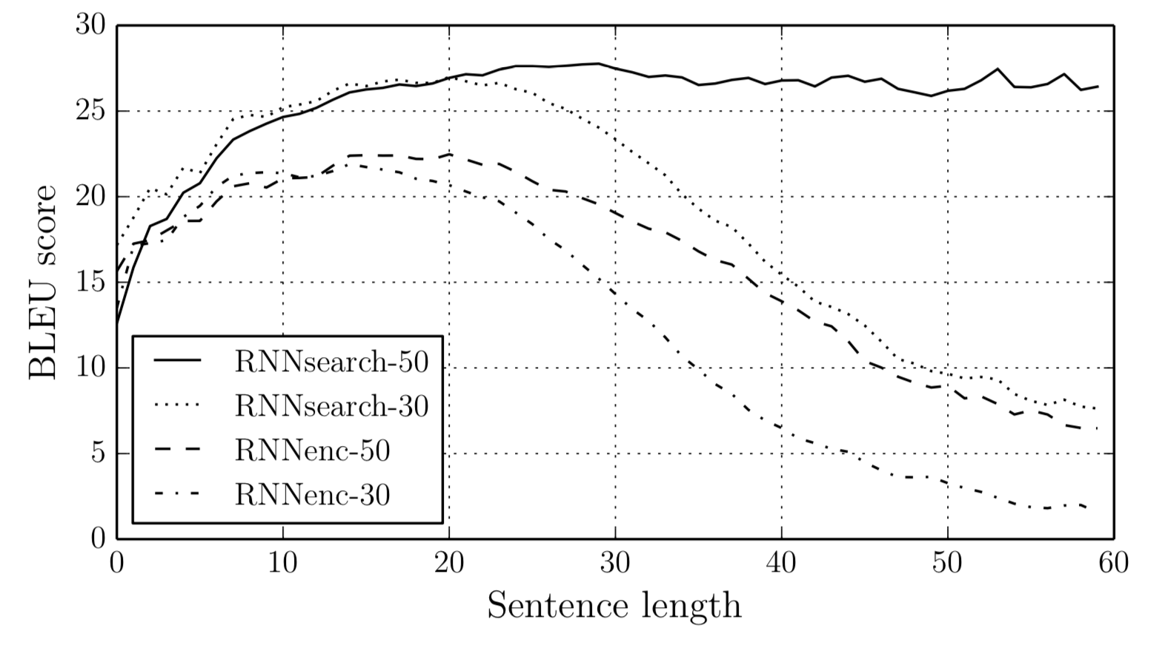
RNN Neural Machine Translation
The model is not pressured to compress the entire source sentence into a single, fixed-size vector:
Greatly improves the translation quality, especially of long sentences.
Much more efficient: less parameters are necessary.
Bahdanau et al. [2015] showed for the first time the machine translation purely based on neural networks could be as good as then-state-of-the-art alternatives (e.g., PBMT).

Slide 45
RNN Neural Machine Translation
Source: An admitting privilege is the right of a doctor to admit a patient to a hospital or a medical centre to carry out a diagnosis or a procedure, based on his status as a health care worker at a hospital.
When collapsed: Un privilège d’admission est le droit d’un médecin de reconnaître un patient à l’hôpital ou un centre médical d’un diagnostic ou de prendre un diagnostic en fonction de son état de santé.
RNNSearch: Un privilège d’admission est le droit d’un médecin d’admettre un patient à un hôpital ou un centre médical pour effectuer un diagnostic ou une procédure, selon son statut de travailleur des soins de santé à l’hôpital.

Slide 46
RNN Neural Machine Translation
Source: An admitting privilege is the right of a doctor to admit a patient to a hospital or a medical centre to carry out a diagnosis or a procedure, based on his status as a health care worker at a hospital.
When collapsed: Un privilège d’admission est le droit d’un médecin de reconnaître un patient à l’hôpital ou un centre médical d’un diagnostic ou de prendre un diagnostic en fonction de son état de santé.
RNNSearch: Un privilège d’admission est le droit d’un médecin d’admettre un patient à un hôpital ou un centre médical pour effectuer un diagnostic ou une procédure, selon son statut de travailleur des soins de santé à l’hôpital.

Slide 47
RNN Neural Machine Translation
Sensible alignment between source and target tokens
Capture long-range reordering/dependencies
Without strong supervision on the alignment
Weakly supervised learning
(Bahdanau et al., 2015; Jean et al., 2015)

Slide 48
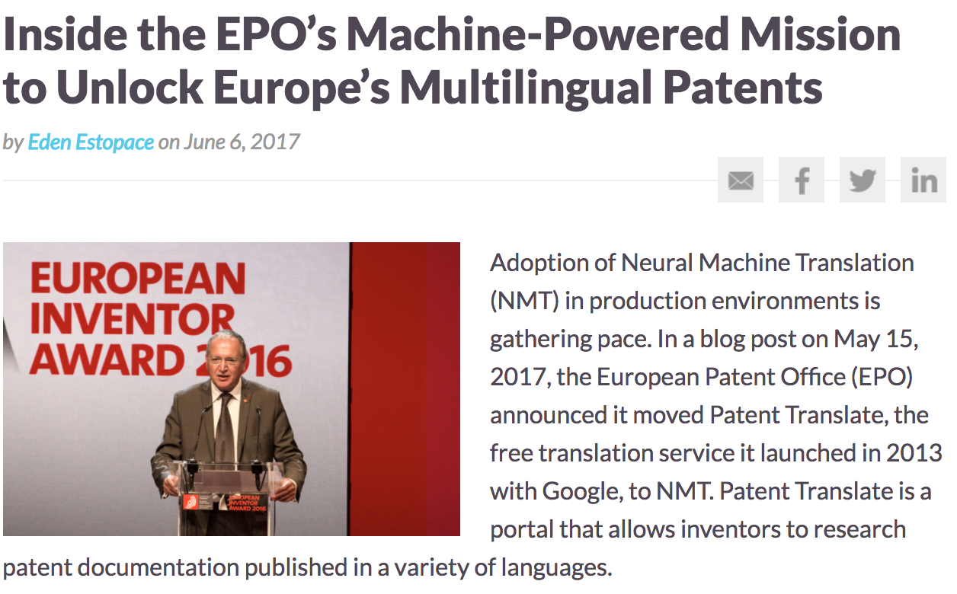
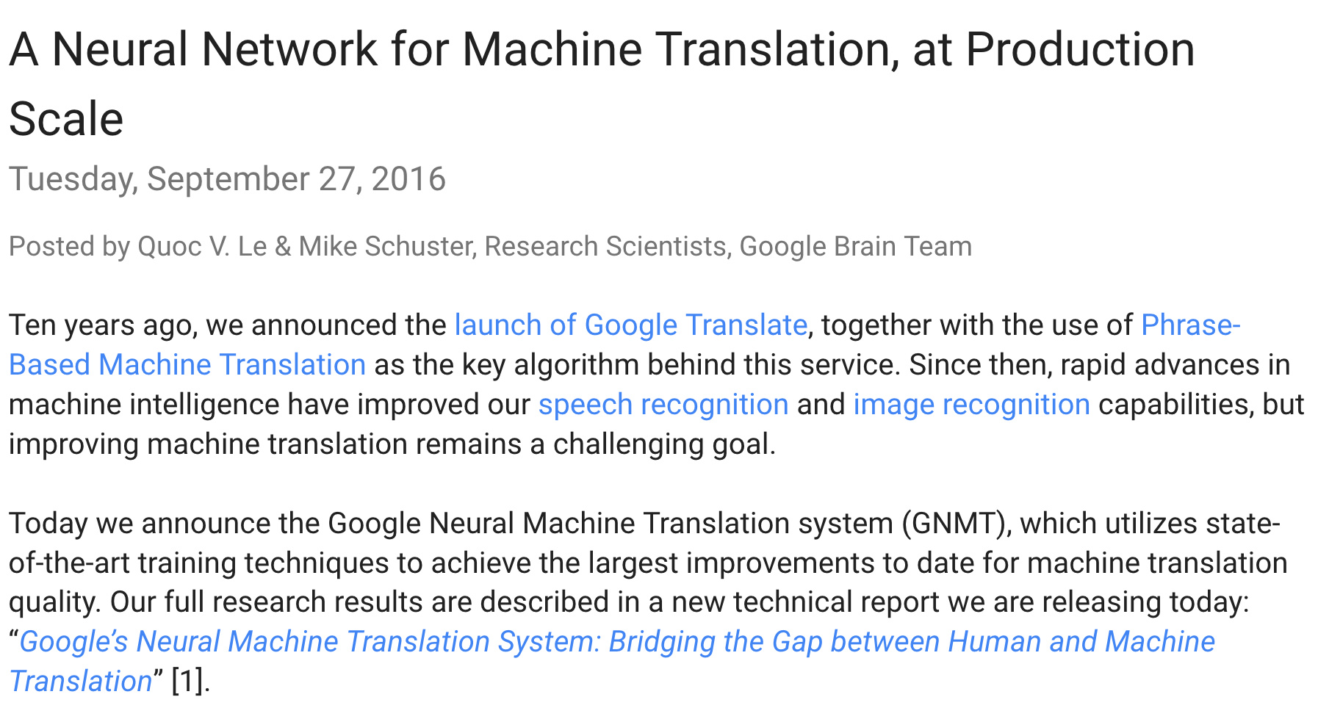

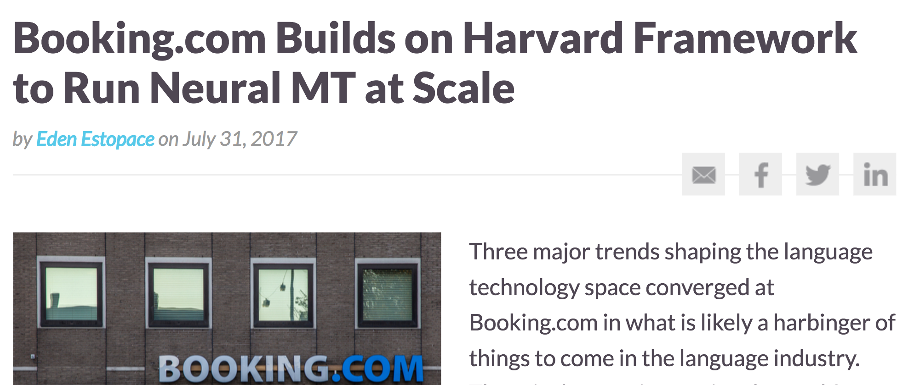
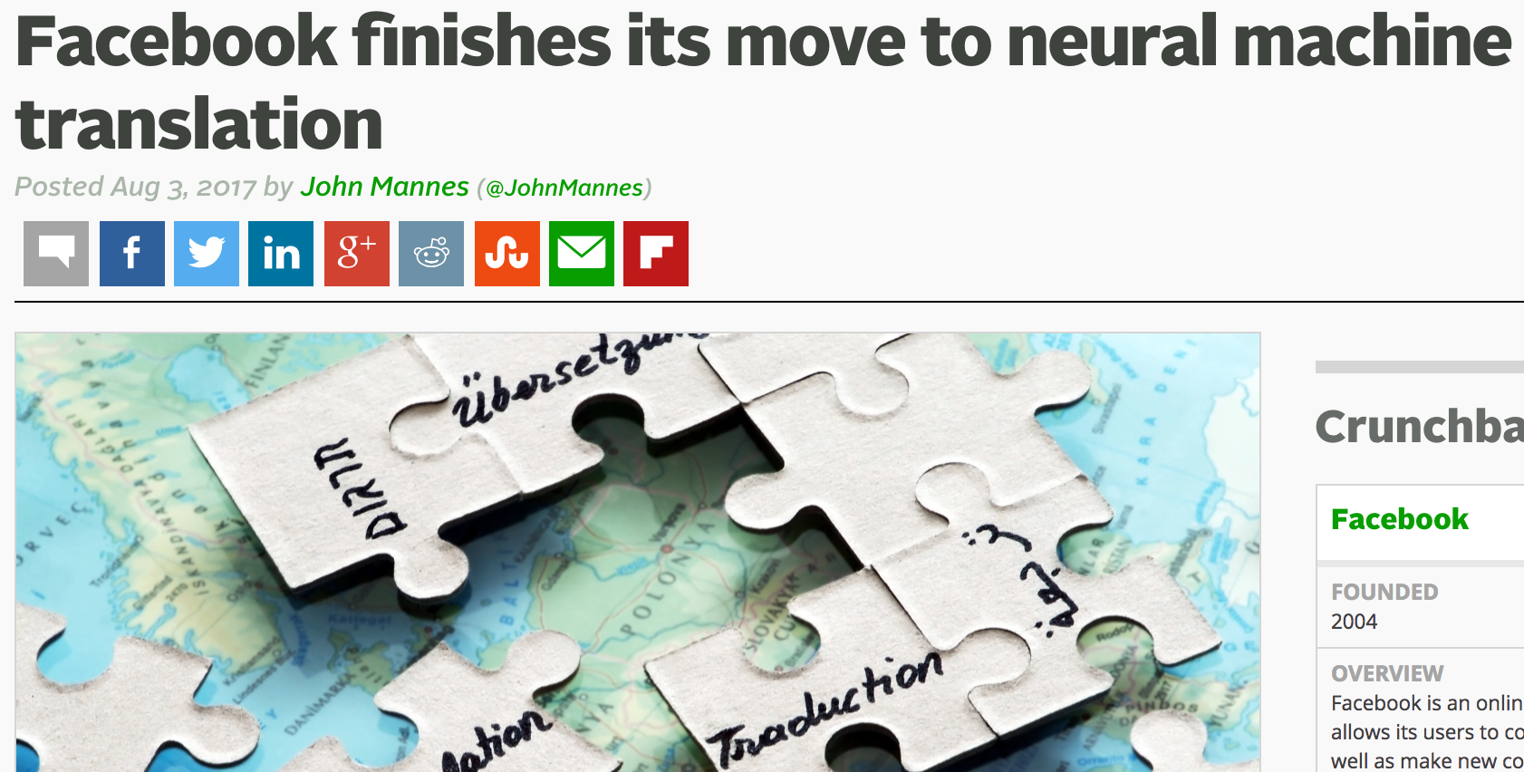
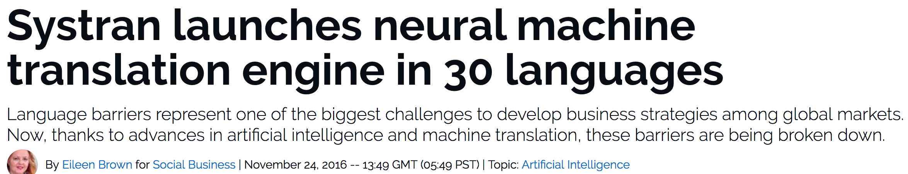
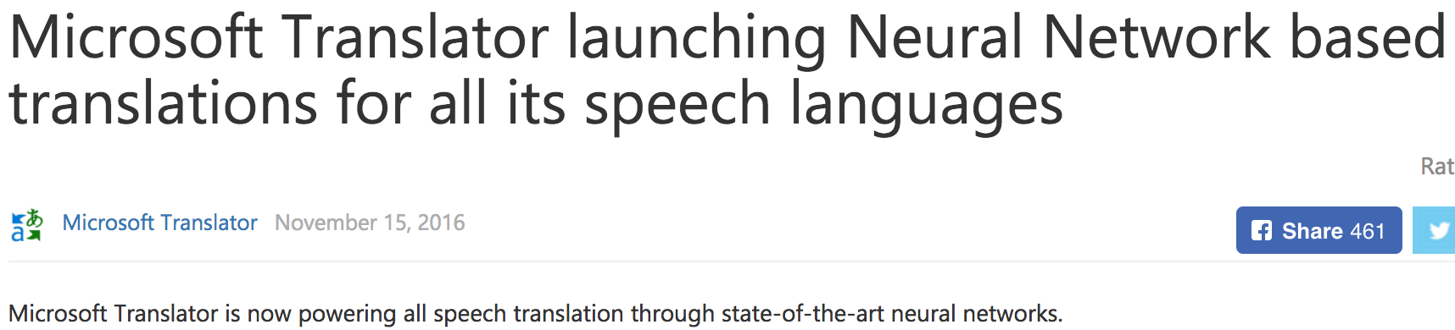

Slide 49
In practice,
Many excellent open-source packages exist:
Marian-NMT https://marian-nmt.github.io/
Compute backend: C++
Maximal efficiency
Supported by Microsoft Translate
FairSeq https://github.com/facebookresearch/fairseq
Compute backend: PyTorch
Supported by Facebook AI Research
Nematus https://github.com/EdinburghNLP/nematus
Compute backend: TensorFlow (originally Theano)
Supported by U. Edinburgh and U. Zurich (Rico Sennrich)

Slide 50
In practice,
Many new architectures are being proposed constantly
Convolutional sequence-to-sequence models [Gehring et al., 2017]
Encoder: CNN-based sentence representation
Decoder: CNN-based conditional language model
Transformers [Vaswani et al., 2017]
Encoder: Self-attention based sentence representation
Decoder: Self-attention based conditional language model
It has been five years only, and a long road lies ahead…

Slide 51
Attention Mechanism
Delving deeper into the attention mechanism

Slide 52
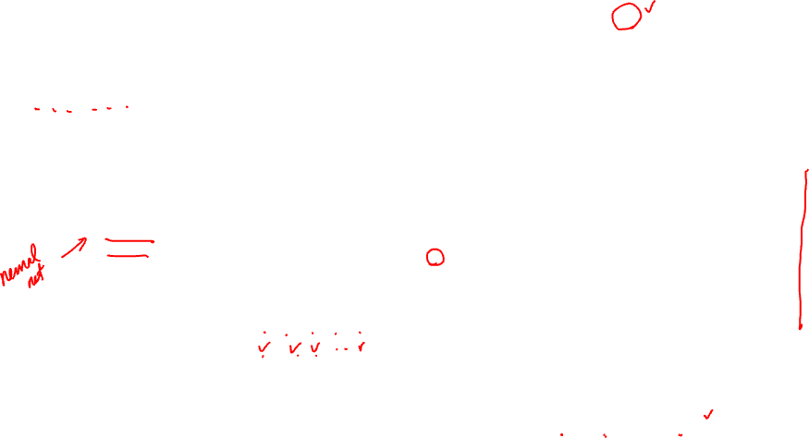
RNN Neural Machine Translation [Bahdanau et al., 2015]
?
Attention mechanism
Which part of the source sentence is relevant for predicting the next target token?
Time-dependent source context vector
Softmax
Source Sentence Representation
Summation
Weighting
Function
RN
Target Sentence Representation

Slide 53
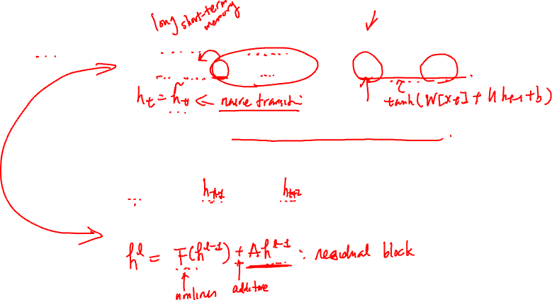
Gated recurrent units to attention
A key idea behind LSTM and GRU is the additive update
This additive update creates linear short-cut connections

Slide 54
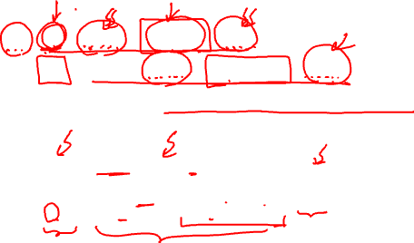
Side-note: gated recurrent units to attention
What are these shortcuts?
When unrolled, it’s a weighted combination of all previous hidden vectors:

Slide 55
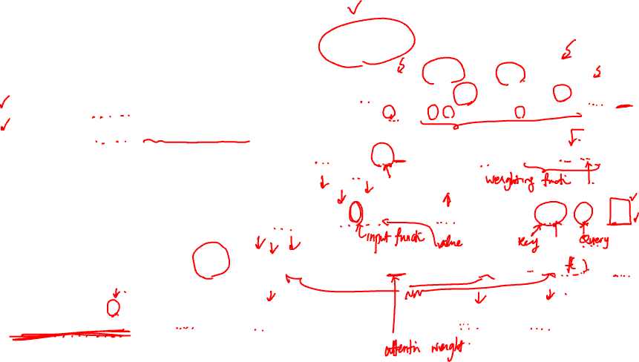
Gated recurrent units to causal attention
0
Can we “free” these dependent weights?
Can we “free” candidate vectors?
Can we separate keys and values?
Can we have multiple attention heads?
1
2
3
4

Slide 56
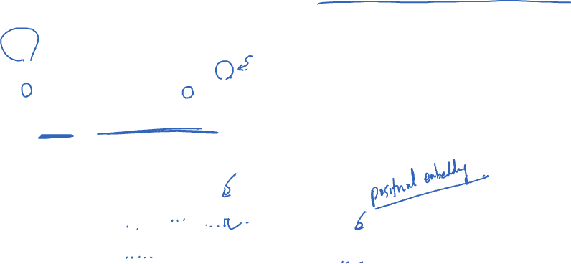
Gated recurrent units to non-causal attention
Look at the entire input sequence
Give the sense of positions

Slide 57
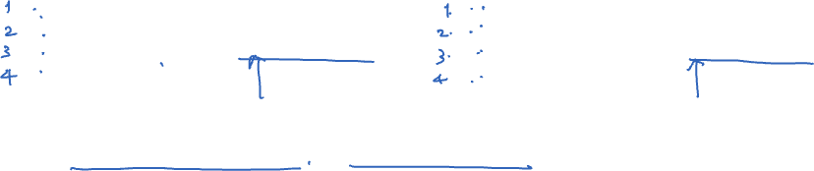
Non-causal attention and positional embedding
Attention is position-invariant:
Add position-specific vectors: positional embedding
Learned positional embedding [Sukhbataar et al., 2016]
Sinusoidal positional embedding [Vaswani et al., 2017]
A
Attention
D
Attention
B
A
C
B
D
C

Slide 58
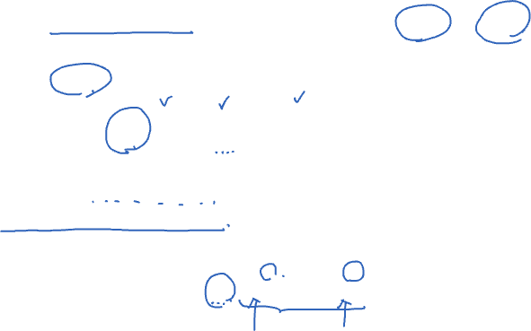
Nonlinear Attention
Attention is inherently linear, b/c it is a weighted sum of input vectors
f is often an identity function. p does not depend on the input.
V is often a linear transformation.
A post-attention nonlinear layer
g is a feedforward neural network and applied to each time step independently
For higher efficiency, g may apply to each head independently as well

Slide 59
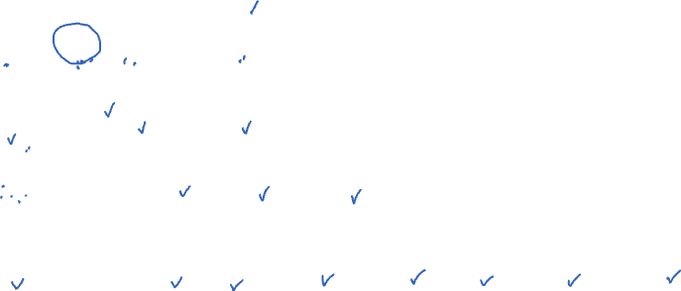
Full self-attention layer

Slide 60
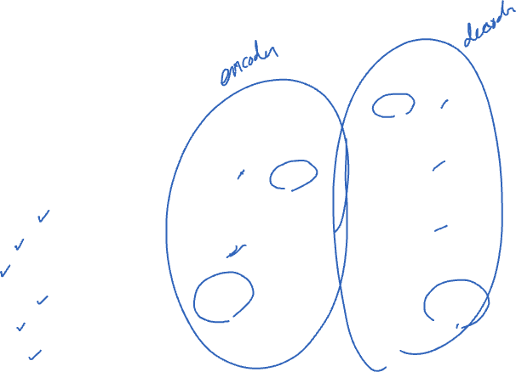
Parametrization – Transformers
Stack multiple layers of attention to build a transformer
Vaswani et al. [2017] – Attention is all you need
A transformer block consists of
Multi-headed attention
Residual connection
Feedforward layer
Point-wise nonlinearity
Residual connection
(Layer) normalization

Slide 61
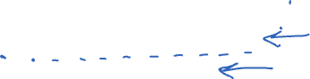
Today we have covered
Recurrent language modeling
Neural machine translation
Attention mechanism

